Slide 1

www.inaaga.ng
‹#›

Slide 2



Inaaga is a ride hailing company helping people get to their destination faster in an easy manner using a mobile app.

Slide 3
The Problem
First Problem
Second Problem
Third Problem
Low income for drivers
Low income for drivers
Time wasting as a result of long waiting for cabs
2

Slide 4
The Solution
First Solution
We have built a mobile app to provide easy, fast and reliable rides for users
Second Solution
Additional source of income for drivers
Third Solution
Opportunity for car owners to make more money
4

Slide 5

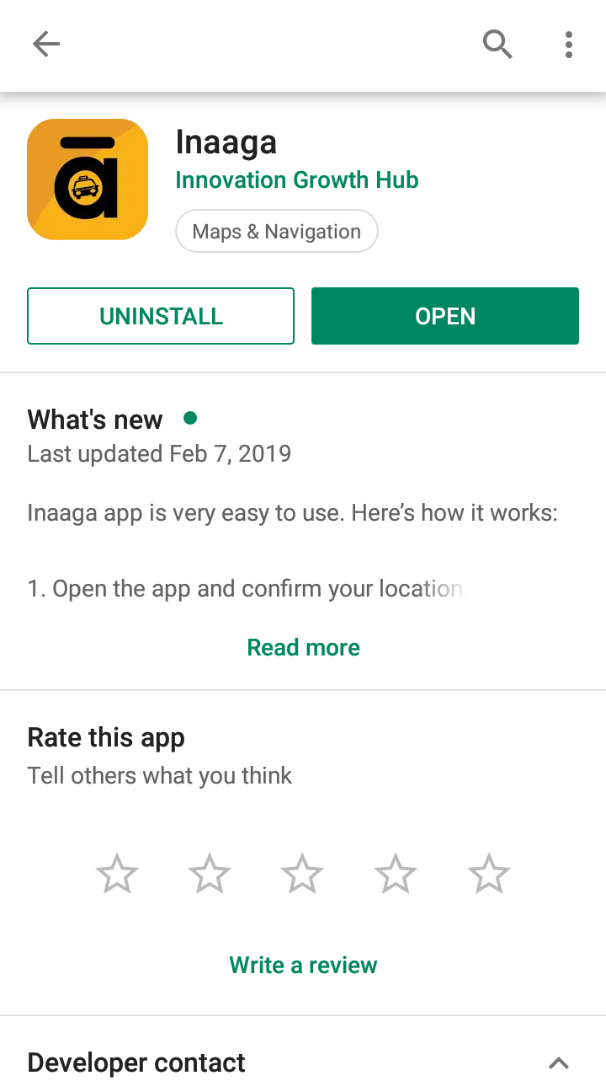

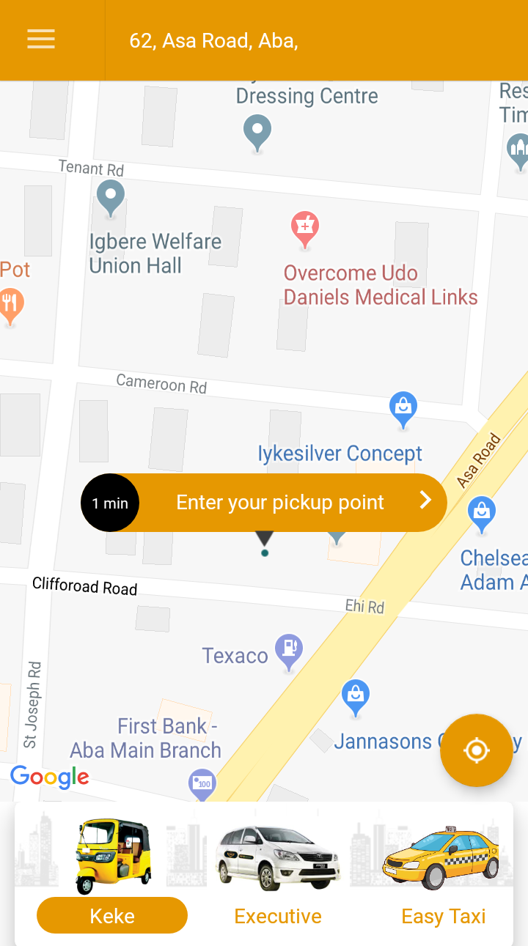
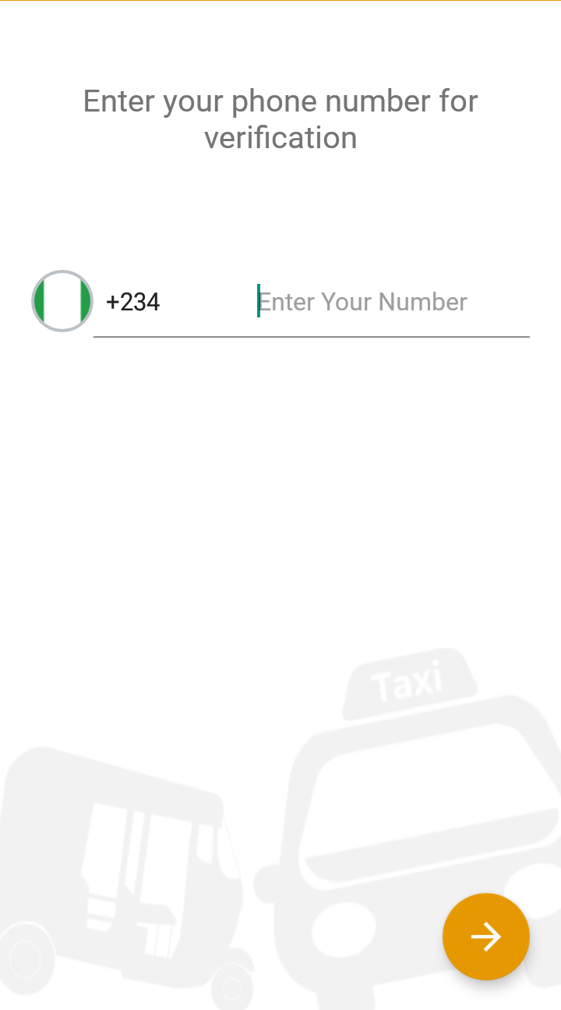
How it Works
Download
the App
Sign up
Book a
Ride
5

Slide 6
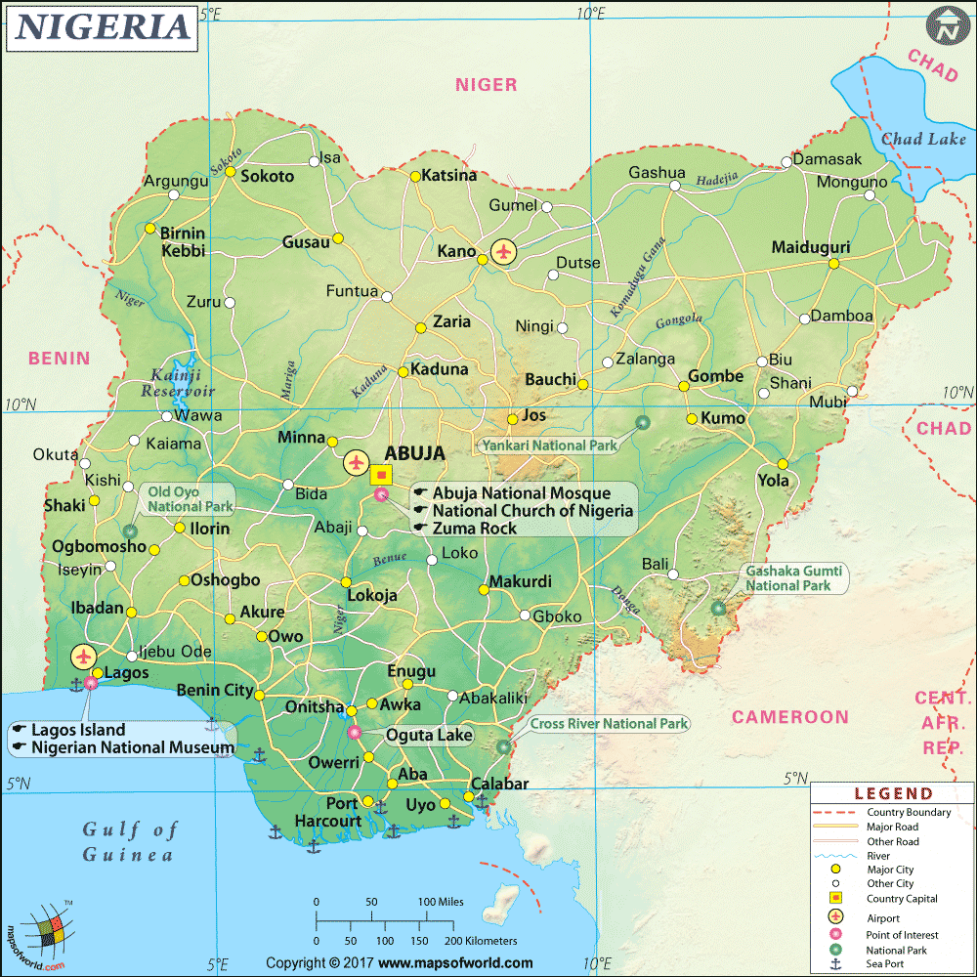
Market Opportunity
11.7million
__
1.1million
__
__
__
__
3
Notes:
The 5 cities have approximately 11.7million inhabitant, targeting just 10% of the population our Total Addressable market is 1.7million

Slide 7
Business Model
K
C
O
Keke
Cabs
Driver Outsourcing
10% of all rides from keke
10% of all rides from cabs
We outsource our drivers to car owners
6

Slide 8



Competitive Landscape
Regular Taxi and Keke Drivers
Oga Taxi
Lead Taxi
Notes:
We are first in town, we are going to use IGHUb marketing model of putting feets on the streets to sign up more drivers than anybody has ever signed up. We have a workforce that we are going to use to sign up drivers.

Slide 9
Traction
DRIVERS
ENGAGEMENT
MONETIZATION
100
10
N75,000,000
Day
MONTH
8
Notes:
15 rides per day - 22.5million month
5 states we will be making 112.5million per month

Slide 10





Our Team
Daberechi Uzoh
Osumgba Chiamaka
Ezinne Uzoije
CEO/Co-founder
CTO/Co-founder
Business Developer/
Digital Marketer
Advisors & Investors
Daniel Chinagozi
Bruce Lucas
Advisor
Advisor
13

Slide 11
Funding Needs
$100,000
Customer Acquisition
Adverts and Marketing
Software Upgrade
We will upgrade our mobile app and also build an ios version
Insurance
Insurance for drivers
Assets Acquisition
Phone Scheme for drivers
16

Slide 12




Thank You
inaagarides
+2348168988303
+2348062147560
support@inaaga.ng
inaagarides
Notes:
Come lets make 557.3 million by the end of 1year.

